Slide 1


Daria Solodey
Methodist, course creator, English teacher

Slide 2
🔥
Our goal
Pass a job interview
Our rules:
Turn on your camera
Set up your microphone
Be active
Notes:
Если вам не хватило места, вы можете здесь написать развернутый комментарий.

Slide 3

Lesson Plan
Practice answering the questions:
Why did you leave your previous job?
What are you looking for in your next job and employer?
Notes:
Развернутый комментарий.

Slide 4
What professions will disappear in the next 10-15 years and which ones will become more common?
Complete the table.
Will more jobs be created or lost because of technology?

Slide 5
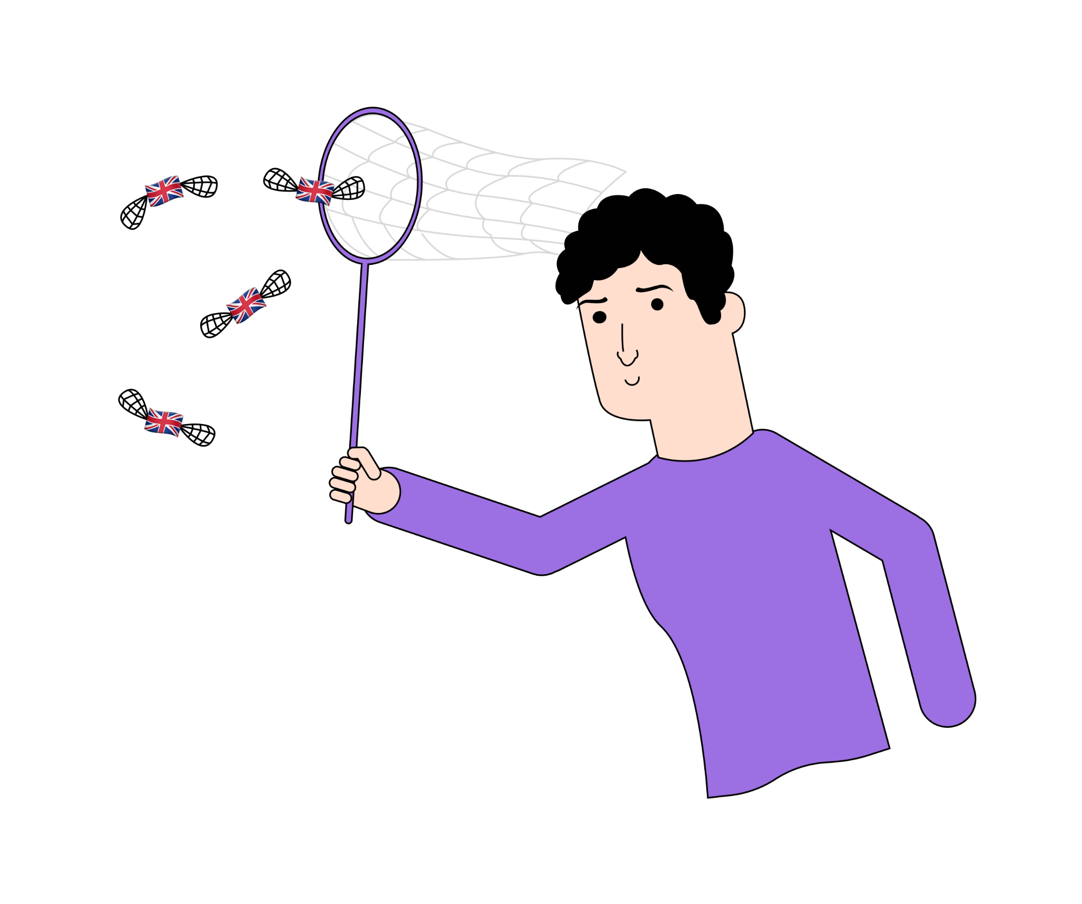
In a moment, you’ll watch a short TED Talk titled:
What will the future of jobs be like?
Before watching, let’s study new words

Slide 6
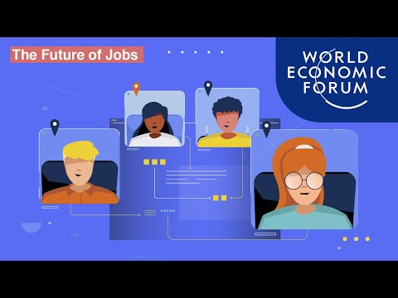
Watch the video and take notes on what these numbers mean
85 5
97
2025 6 1 2 40
2026 70 2 5
2/3 1

Slide 7
Check yourself.
The ongoing shift in the division of labour between humans, machines and algorithms might displace 85 million jobs in the next 5 years.
97 million new roles may emerge.
By 2025, companies expect to displace roughly 6% of their total workforce, 1 in 2 workers will need reskilling, and those remaining in their current roles will need to update 40% of their skills set.
By 2026, organisations say will train over 70% of their employees. It will take on average between 2 weeks and 5 months for workers to pick up new skills.
2/3 of employers expect to get a return on investment in employees' reskilling within just one year.

Slide 8
Answer the questions.
What are the things that humans can do and machines can’t?
Who might be affected positively and negatively by the addition of robots in the workforce?
What might happen to many jobs in the next 5 years?
Do you agree that technology steals people’s jobs?
How can we change the education to prepare new generations for jobs of tomorrow?

Slide 9

Answer the questions
Why are so many people called switchers nowadays?
How should you speak about changing jobs at the interview?

Slide 10
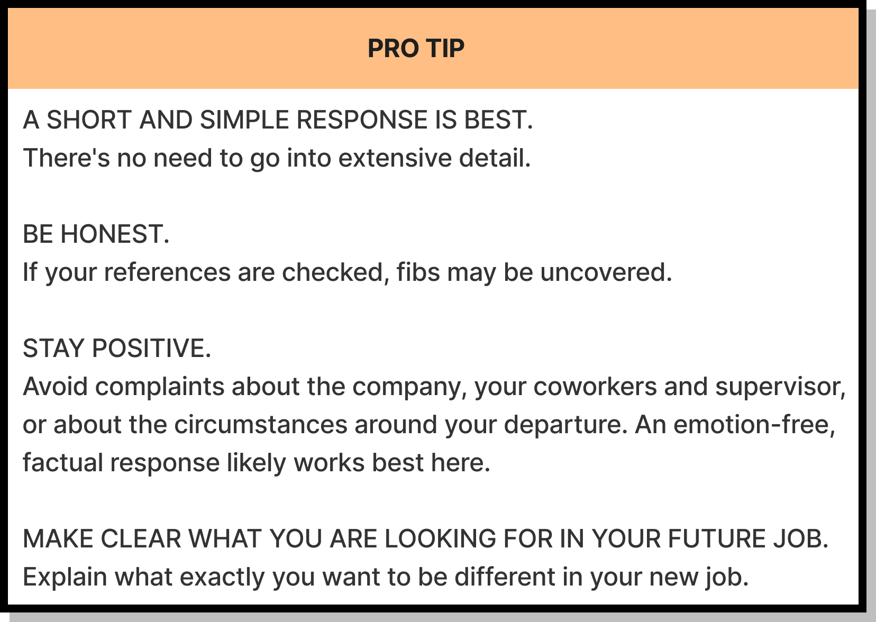

Why did you leave your previous job?

Slide 11
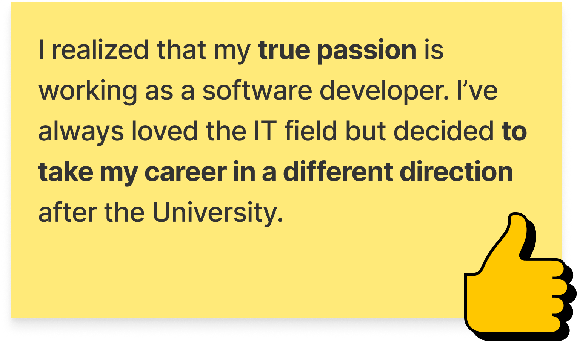

Why did you leave your previous job?
I wanted to change my career direction.
My job was out
of demand.
Technology is my true passion.
What are you looking for in your next job and employer?

Slide 12
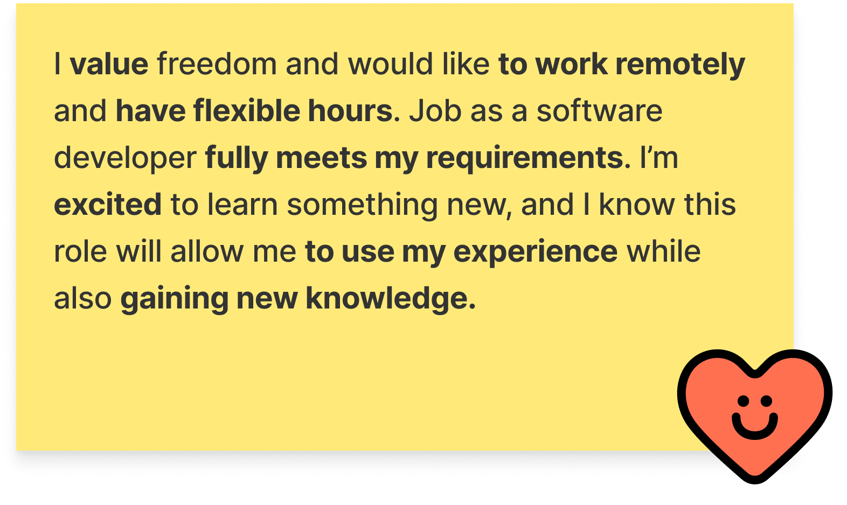
What are you looking for in your next job and employer?
*This question may be a part of “Why did you leave your previous job?” or a separate interview question
I want to start my career…
It is important for me…
I want to be able to…
I am excited to…
I value…
TRUE/FALSE - Why (not)?
Salaries and benefits should be the focus of your answer.
Notes:
ANSWER THE QUESTION OR PRESENT THE ANSWER AT THE NEXT CLASS

Slide 13
What are you looking for in your next job and employer?
I want to start my career…
It is important for me…
I want to be able to…
I am excited to…
I value…
FALSE
Salaries and benefits should NOT be the focus of your answer.

Slide 14

What can you do after this lesson?
I learned:
How to answer the questions:
Why did you leave your previous job?
What are you looking for in your next job and employer?
Notes:
Развернутый комментарий

Slide 15
Useful links:
Tasks:
https://wordwall.net/ru/resource/35694362 - jobs
https://wordwall.net/resource/35819887 - vocabulary

Slide 16
Thank you!

